Slide 1



Slide 2

Notes:
Hello and welcome

Slide 3

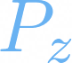


Notes:
In this video we will explore the symmetry of the pz orbitals in the benzene molecule.
Write animation of the text in this slide
Benzene fades in with alpha transition

Slide 4

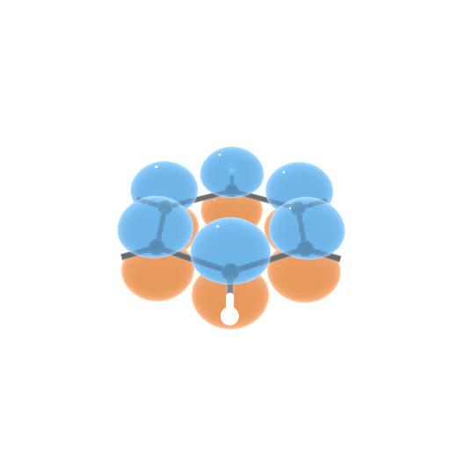



Notes:
Benzene belongs to the D6h point group, which has the following character table.
Write animation
Point group:
Table
(Considering keeping the logos out until the end)

Slide 5
Notes:
Write out the Basis set and point group parts Start rotating the benzene molecue along the z axis

Slide 6
Notes:
More specifically, we will look at how the symmetry operations of benzene affect the pz orbitals of atoms that remain in position when performing the symmetry operations outlined in the table.
Start animating some symmetry operations while the molecule rotates along the Z axis (preferably do the C2’ rotations)
Start fading out the table and writing down a “vector” with all the symmetry labels.

Slide 7
Notes:
The molecule should still be rotating at this point
We will use this information to construct a vector, also called the trace of the basis set…
Use the write animation to write the Gamma vector under the symmetry labels
that fully describes what happens to all the orbitals due to all symmetry operations.

Slide 8
Notes:
Fades out the benzene molecule
Move the vectors to the left side of the screen
Fade animation to bring the table back
This vector turns out to be a linear combination of rows in the character table.
Highlight the labels of the rows

Slide 9
Notes:
Fade everything out but the gamma vector
Write animation for the linear combination
And since these rows, called irreps, are orthogonal, we will later make use of the little orthogonal theorem to find out exactly which ones are present in the trace.

Slide 10
Notes:
Write everything out and leave it back for a tiny bit

Slide 11
Notes:
Carry on the normal animation while narrating

Slide 12

Notes:
As the narrator talks, the images of one of each kind of symmetry operation go up to below the header

Slide 13
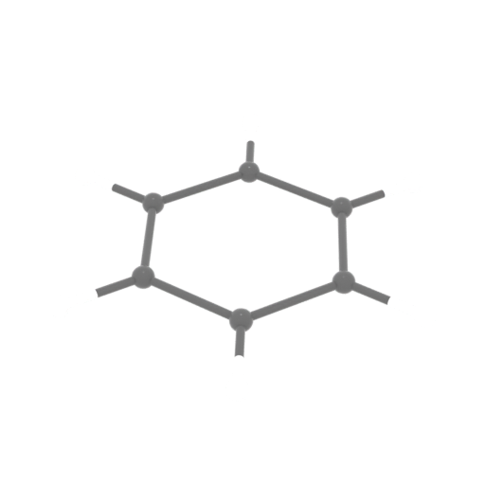


Slide 14
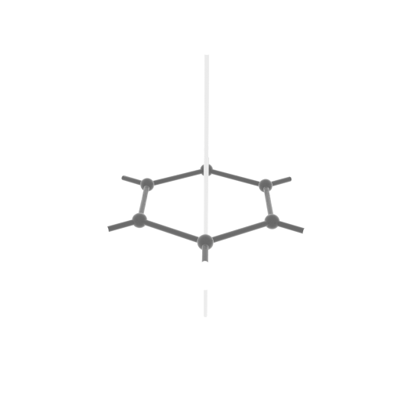
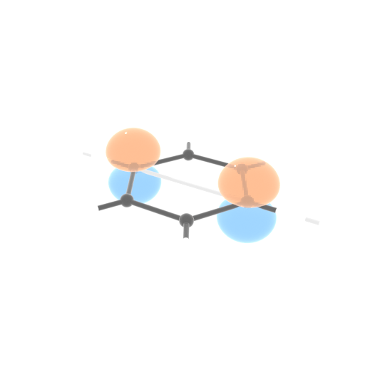
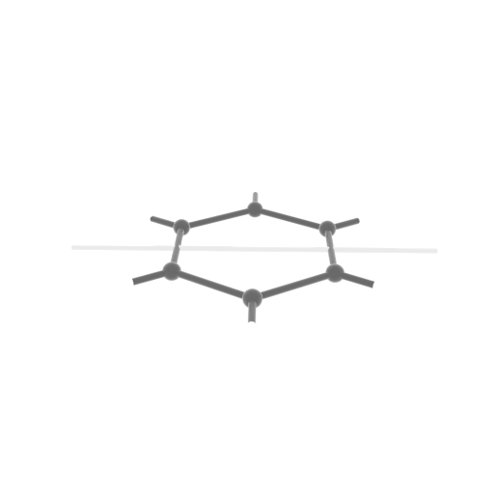
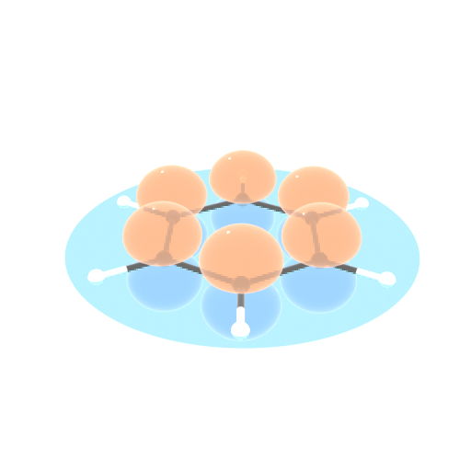
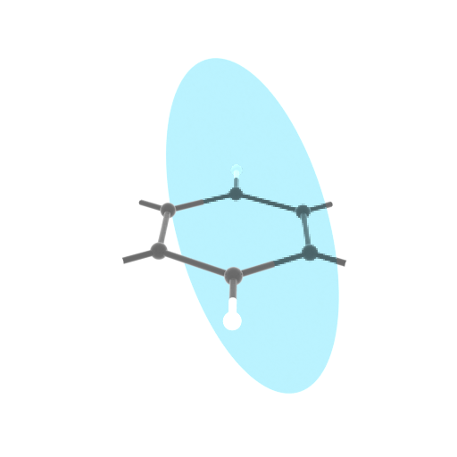
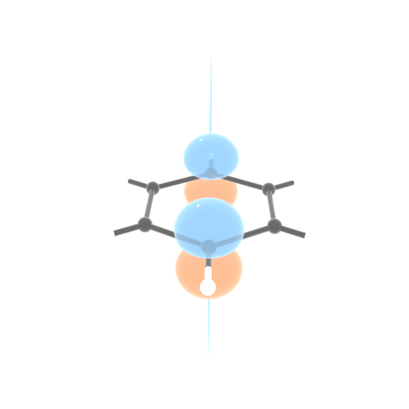
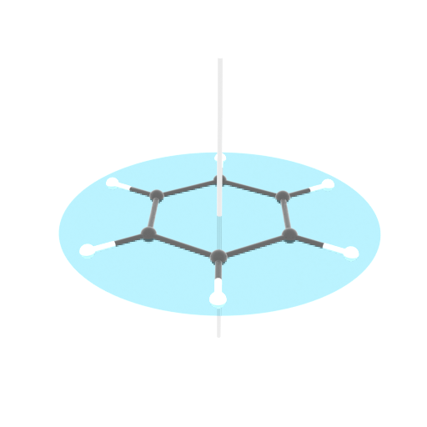



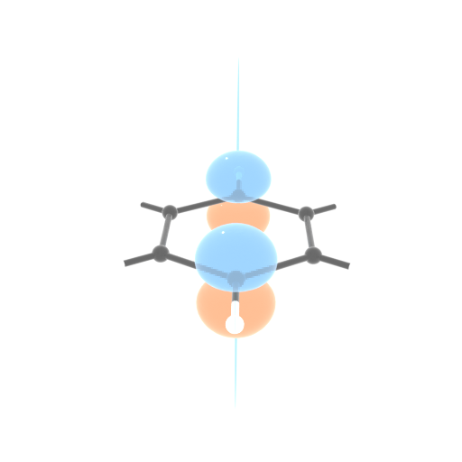
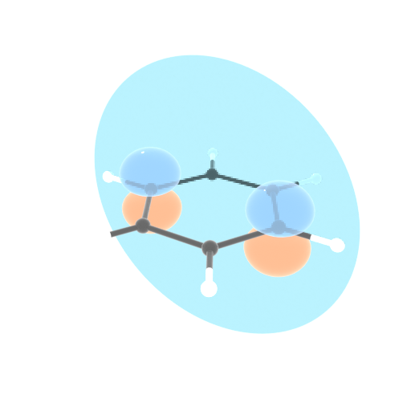

Slide 15
Notes:
Now that you are familiar with all the symmetry operations we can carry out on benzene and what happens to the orbitals, we can fill in the vector.
The rules are that the orbital only contributes to the trace if the atom to which it pertains stays in place and that if the orbitals have an inversion in their orientation, they have a negative contribution.
When all the symmetry operations have finally happened, lower the images of each benzene and show one picture for each symmetry opearation

Slide 16
Notes:
Before moving on, note how the contribution from each operation within the same conjugacy class is identical! That means you only need to find one representative axis for each operation to construct the trace.
Furthermore, we fill in the values on the trace:
Write or fade in animation of the empty trace:
As each symmetry operation is described, the a box around the figures or highlight indicates that that’s the group being discussed. By the end of each description the numbers go down to the trace vector.

Slide 17
Notes:
When the trace vector is full, fade out the images and the header and write again the expression equating Gamma to a linear combination of irreps.
Now we use the little orthogonality theorem to check how many irreps of A1g symmetry are present: 0
Then we use the little orthogonality theorem to check B2g: 1
For each of the two animations above, give emphasis to the table (increase alpha) and indicate where the vector comes from and take the dot product with the trace to extract the number of times it shows up there.
Say that doing the same to all irreps gives the following linear combination:

Slide 18


Slide 19
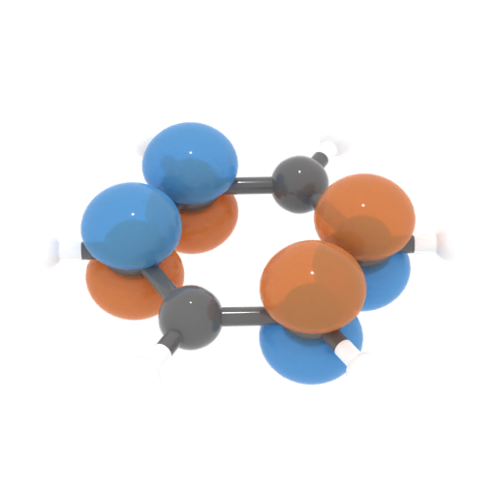
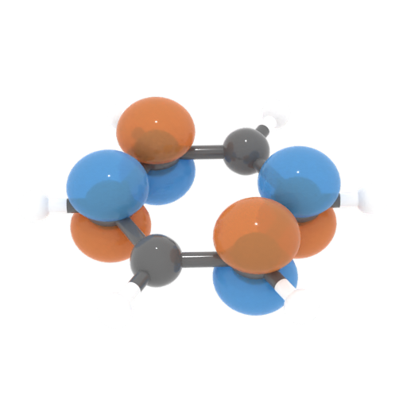
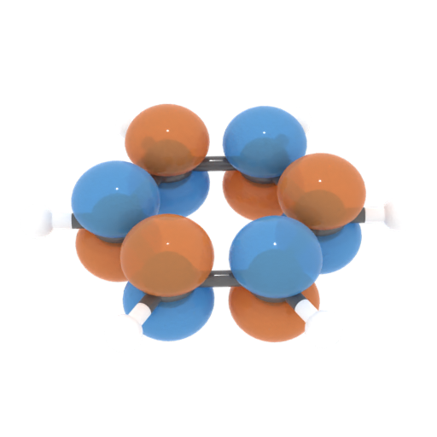
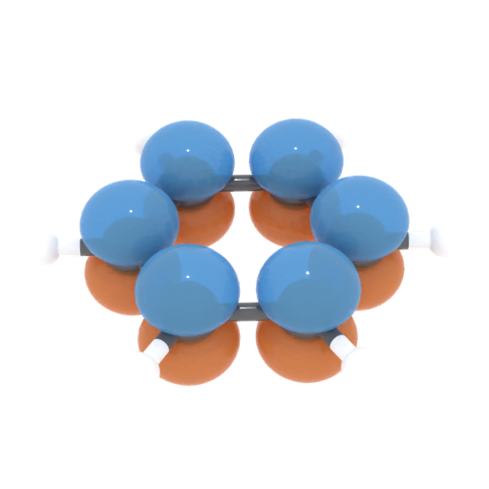
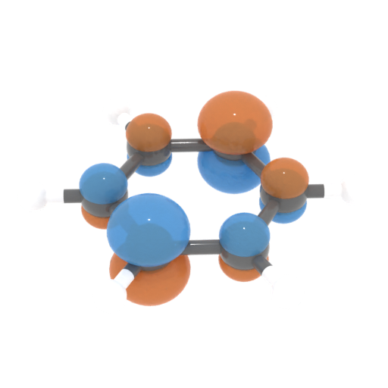
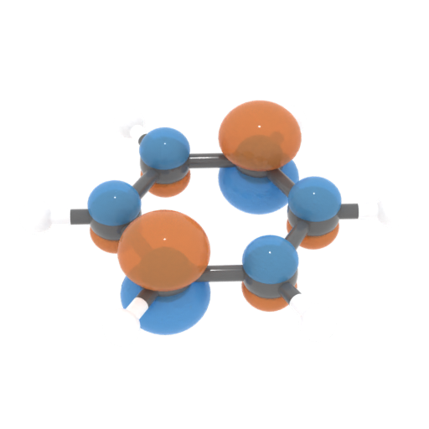
Notes:
Tease them into watching more clips by showing the molecular orbitals that can be generated from these irreps.

Slide 20
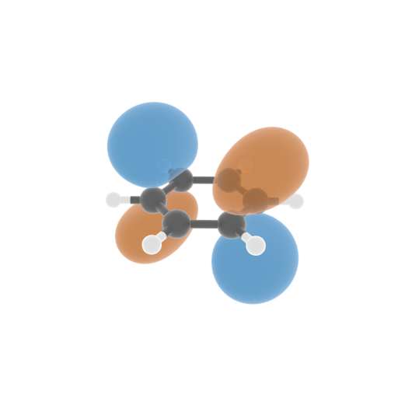
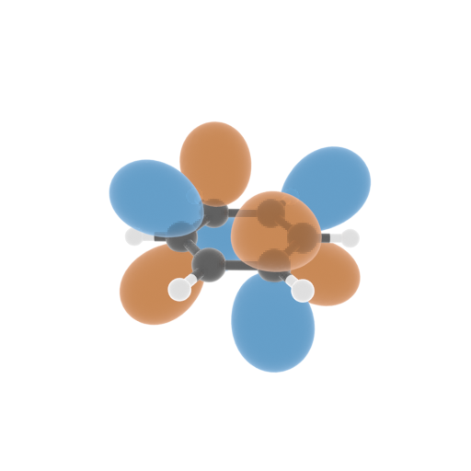
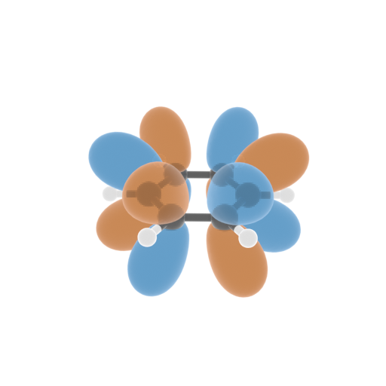
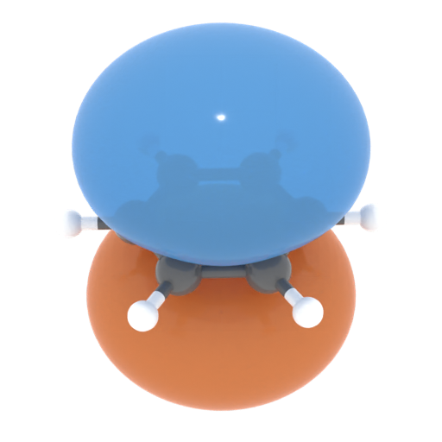
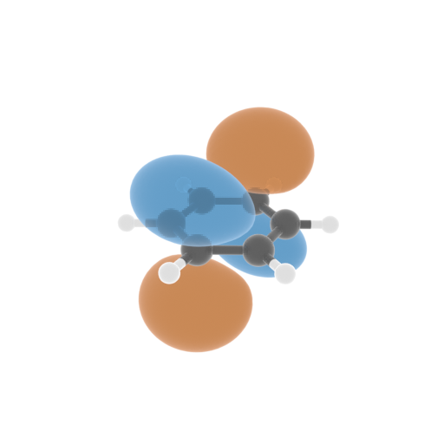
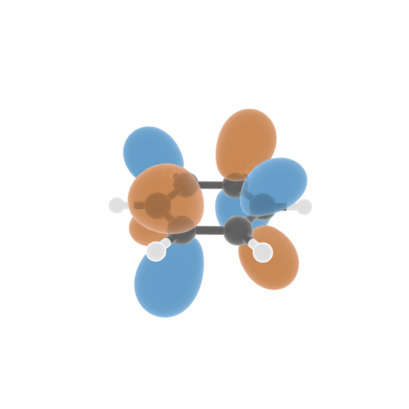
Notes:
Show what the electron clouds would look like from this purely geometrical treatment while being clear that energy optimization would give the “true” orbitals.

Slide 21




Notes:
Acknowledgementssss

